Slide 1

Travel Visa Inequality

Slide 2
MOTIVATION
The visa policies are changing rapidly with an intention to make the travel and exploration easier
Even with rapid change, there is still inequality in travel policies
We as international students, also had to go through many visa procedures before coming here for education. This motivated us to explore the visa inequalities while travelling to and from different countries
The current immigration situations is one of the major reason which motivated to find the factors affecting the visa free mobility

Slide 3
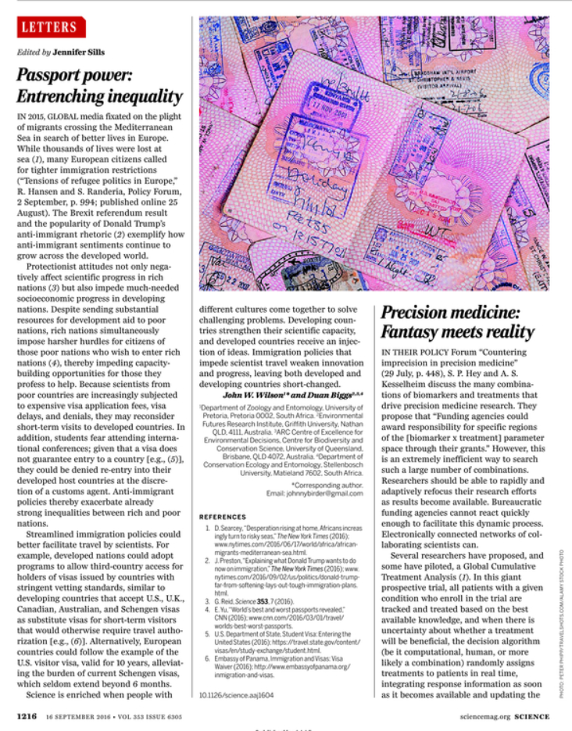
Passport Power
Immigrant situation is critical
Impede the progress
Lack of opportunities
Difference in behavior
Financial Restrictions
Schengen Countries vs. USA

Slide 4

The new Passport - poor
Passport – Document to travel or Document proving Residence ?
Effect of technology on Travel Policies
Passport still a document lacking technology?
Does country of origin alone affect or support visa free travel?

Slide 5
OBJECTIVE
The main objective of this project to put forth a set interactive visualization where on can see the passport index across all the countries, different visa polices for a country compared to other countries, highlighting the advantages and disadvantages for each country
How the visa index and GDP per capita changed over the years.
How the visa index impacts the outgoing and incoming flow of people
The objective of the project is to raise awareness for existing inequalities between different countries- one of the inequality

Slide 6


DATA Source 1
code1 | code2 | visa_type1 | Visa type2
AFG | AFG | 5 | 5
AFG | AGO | 4 | 4
AFG | ALB | 4 | 4
AFG | ARE | 4 | 4
AFG | ARG | 4 | 4
AFG | ARM | 4 | 4
AFG | AUS | 3 | 4
AFG | AUT | 4 | 4
AFG | AZE | 4 | 4
AFG | BDI | 4 | 4
AFG | BEL | 4 | 4
AFG | BEN | 4 | 4
AFG | BFA | 4 | 4
AFG | BGD | 1 | 4
Data Description of Visa Type:
0: Visa Not required
1: Visa on Arrival
2: ETA Required
3. eVisa Required
4. Visa Required
5. Same Country

Slide 7
DATA Source 2
Country Name | Code | Score | Year
Denmark | DNK | 130 | 2006
Finland | FIN | 130 | 2006
United States | USA | 130 | 2006
Germany | DEU | 129 | 2006
Sweden | SWE | 129 | 2006
Ireland | IRL | 129 | 2006
France | FRA | 128 | 2006
Italy | ITA | 128 | 2006
Japan | JPN | 128 | 2006
United Kingdom | GBR | 128 | 2006
Luxembourg | LUX | 125 | 2006
Switzerland | CHE | 127 | 2006
Norway | NOR | 127 | 2006
Belgium | BEL | 127 | 2006
Data is scraped using python requests library.
Score~ Henley Passport index
Year ~ 2006 -2019
https://www.henleypassportindex.com/passport

Slide 8
DATA Source 3
Country code | gdp_percapita | Incoming | Outgoing
CAN | 42752.66 | 16590000 | 32977000
ITA | 35685.6 | 47704000 | 29060000
CZE | 29017.84 | 9004000 | 5304000
ALB | 9930.94 | 2857000 | 3928000
CHL | 21942.15 | 3576000 | 2999000
SVN | 23295.34 | 2259000 | 2612000
CYP | 28224.46 | 2405000 | 1026000
BOL | 6131.06 | 798000 | 837000
KHM | 1006.84 | 2882000 | 710000
Data contains GDP per capita, incoming volume and outgoing volume.(~2018)
Kaggle.com

Slide 9
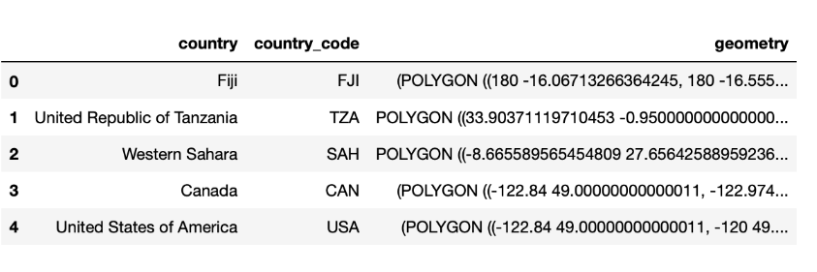
DATA Source 4
Shape file of countries
https://www.naturalearthdata.com/downloads/110m-cultural-vectors/

Slide 10
DATA Source 5
Country | Code | Longitude | Latitude
Aruba | ABW | -69.9827 | 12.52088
Afghanistan | AFG | 66.00473 | 33.83523
Angola | AGO | 17.53737 | -12.2934
Anguilla | AIA | -63.065 | 18.22396
Albania | ALB | 20.04983 | 41.14245
Aland | ALD | 19.95329 | 60.21489
Andorra | AND | 1.560544 | 42.54229
United Arab Emirates | ARE | 54.30017 | 23.90528
Argentina | ARG | -65.1798 | -35.3813
Armenia | ARM | 44.92993 | 40.28953
American Samoa | ASM | -170.718 | -14.3045
Antarctica | ATA | 19.92109 | -80.5086
Ashmore and Cartier Islands | ATC | 123.5838 | -12.4299
Country centroids data
https://www.naturalearthdata.com/downloads/110m-cultural-vectors/

Slide 11
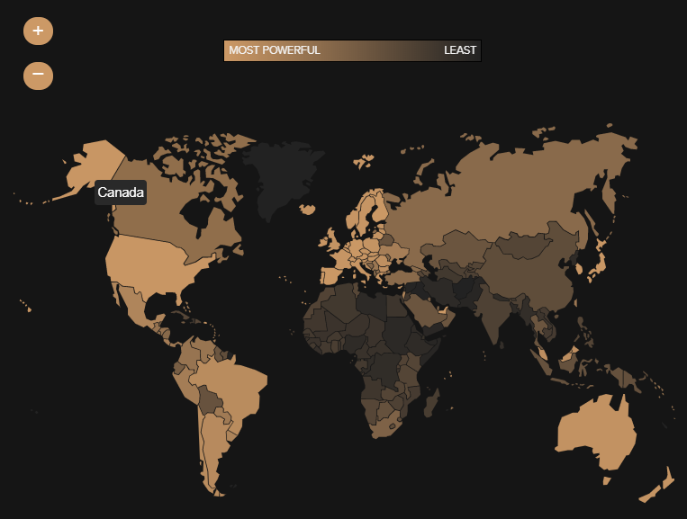
RELEVANT WORK
https://www.passportindex.org/

Slide 12
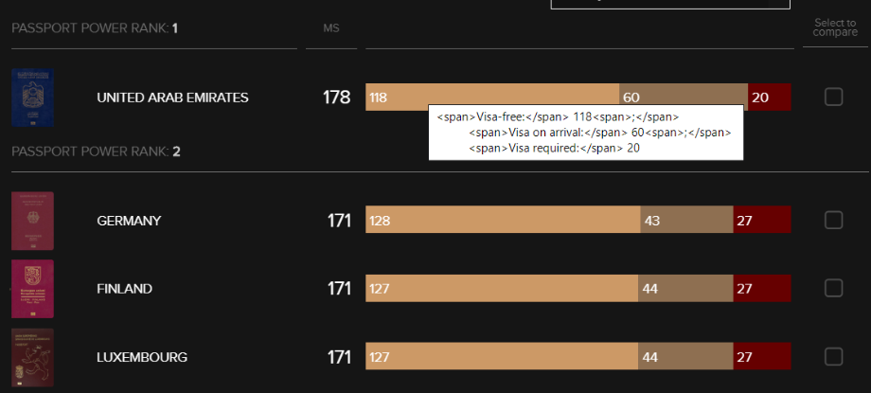
RELEVANT WORK
https://www.passportindex.org/

Slide 13
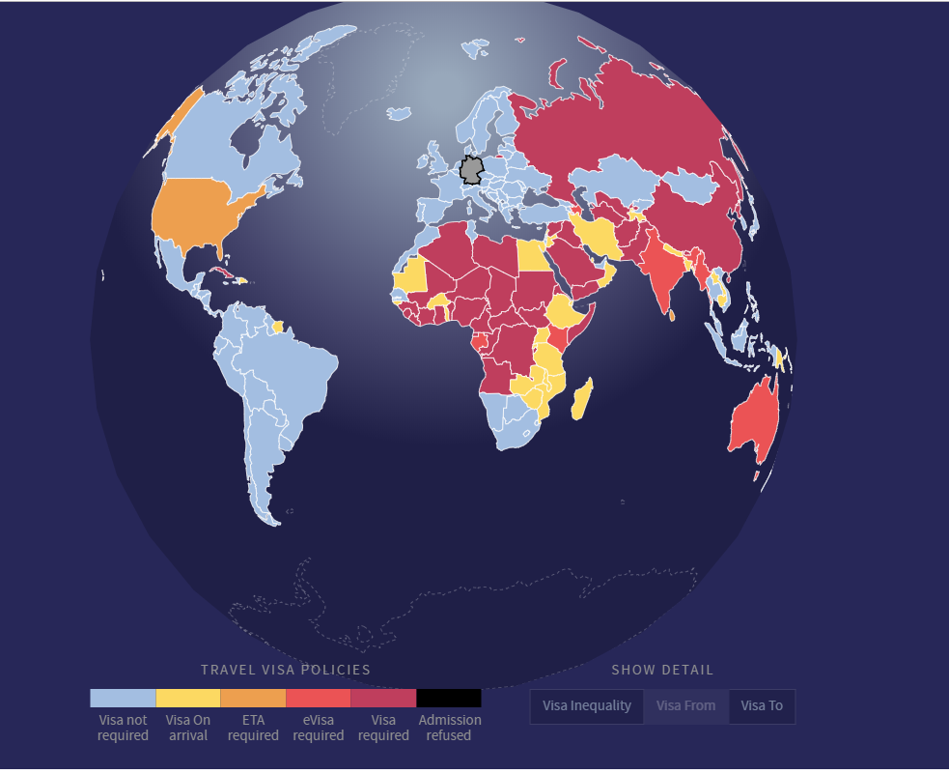
RELEVANT WORK
https://projects.christianlaesser.com/travel-visa-inequality/

Slide 14
VISUALIZATION
Scatter plot (Bokeh, JSCustomCallbacks, Pandas,Widgets, Palettes)
Bar Plot (Bokeh, ColumnDataSource, Palettes)
Line Plot (Bokeh, Select Widget, Hover, Palettes)
Map Visualization (Bokeh, GeoJSON, ColorMapper, Hover, Select Widget, ColorBar, Palettes)

Slide 15
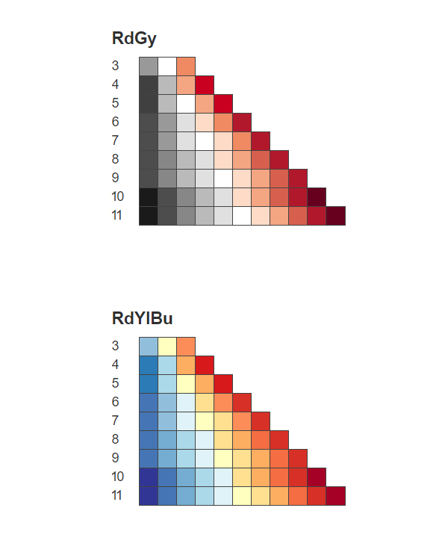
bokeh.palettes - RdYlBu7, RdGy7
http://docs.bokeh.org/en/1.3.2/docs/reference/palettes.html

Slide 16
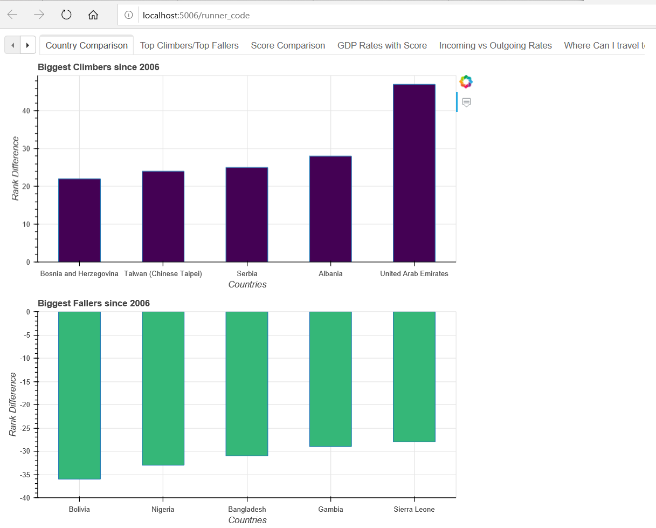
Biggest Climbers vs. Biggest Fallers

Slide 17
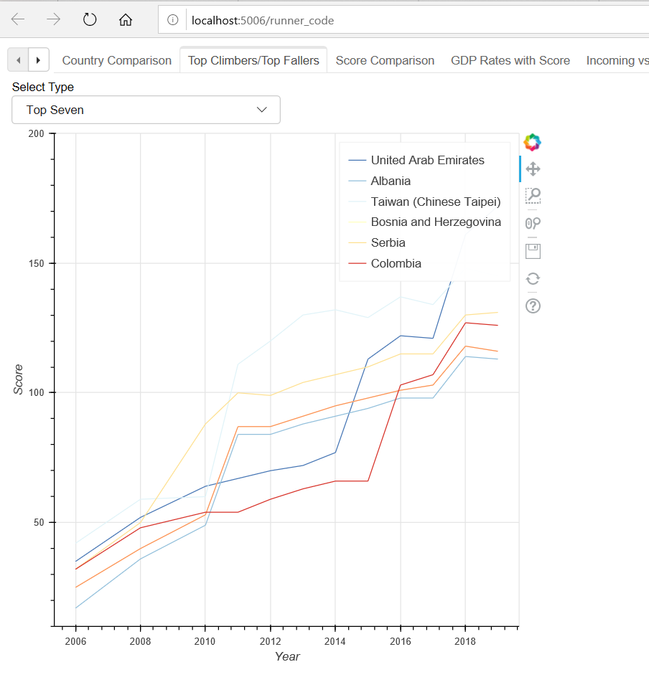
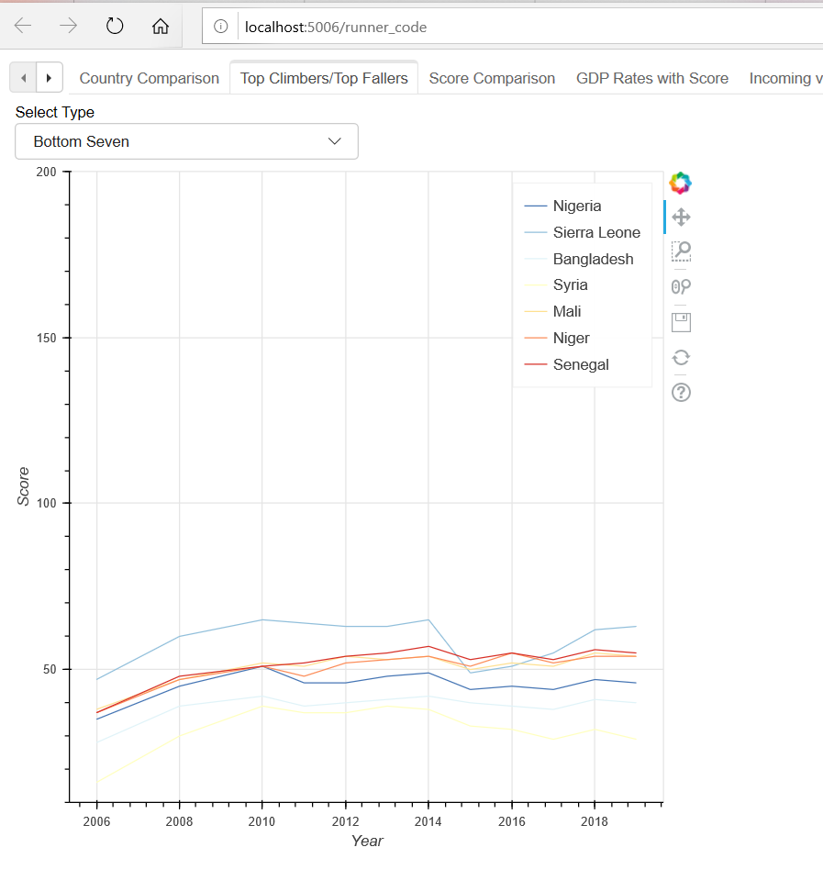
Top Seven Vs. Bottom Seven

Slide 18
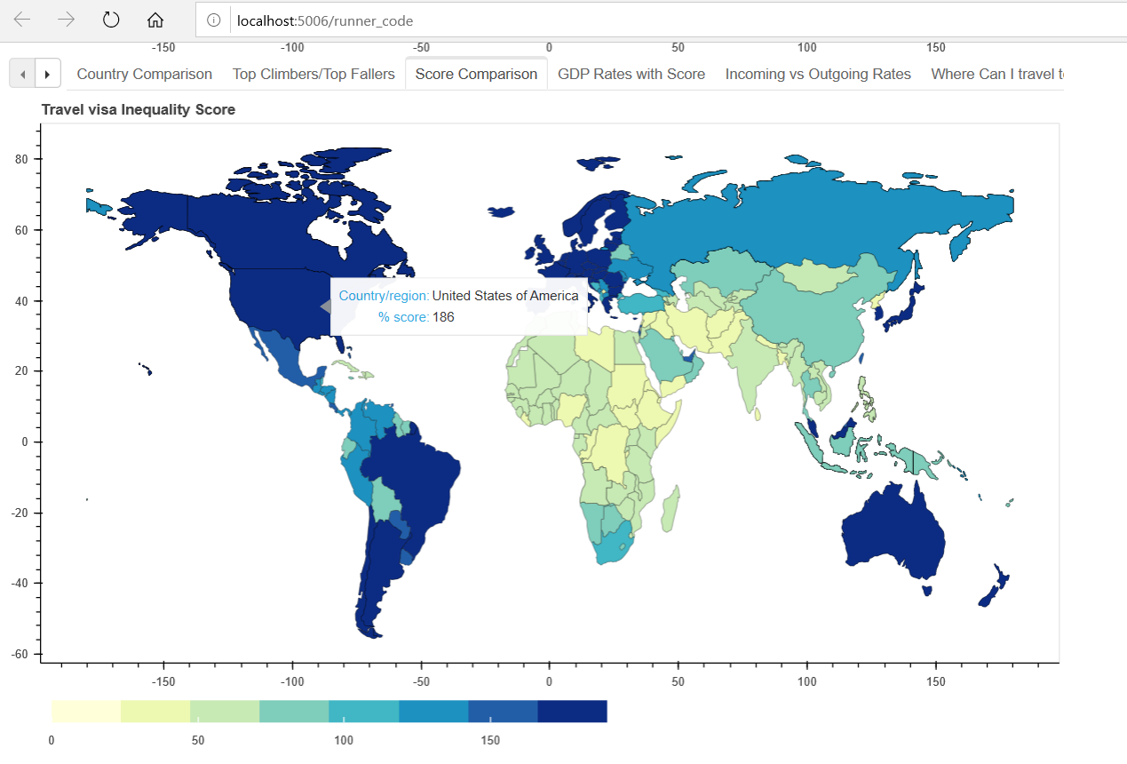
Visa index gradient map

Slide 19
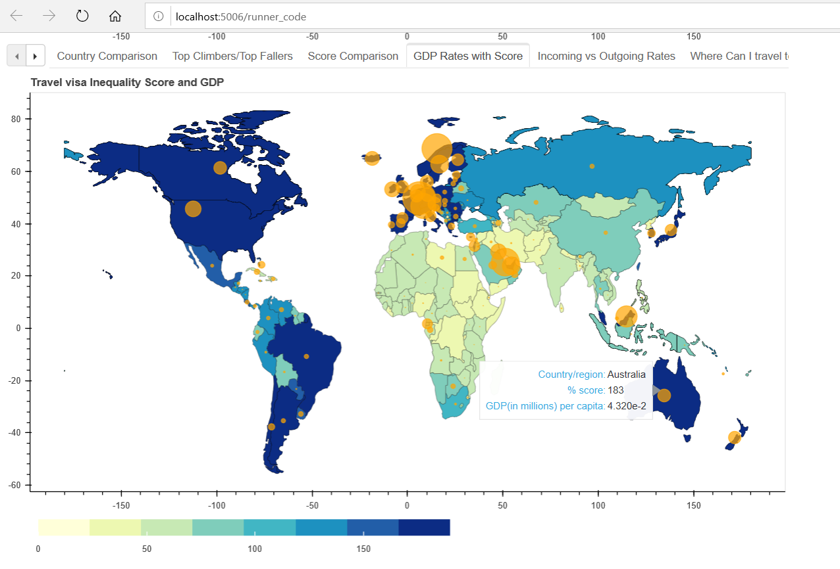
GDP Per Capita Comparison

Slide 20
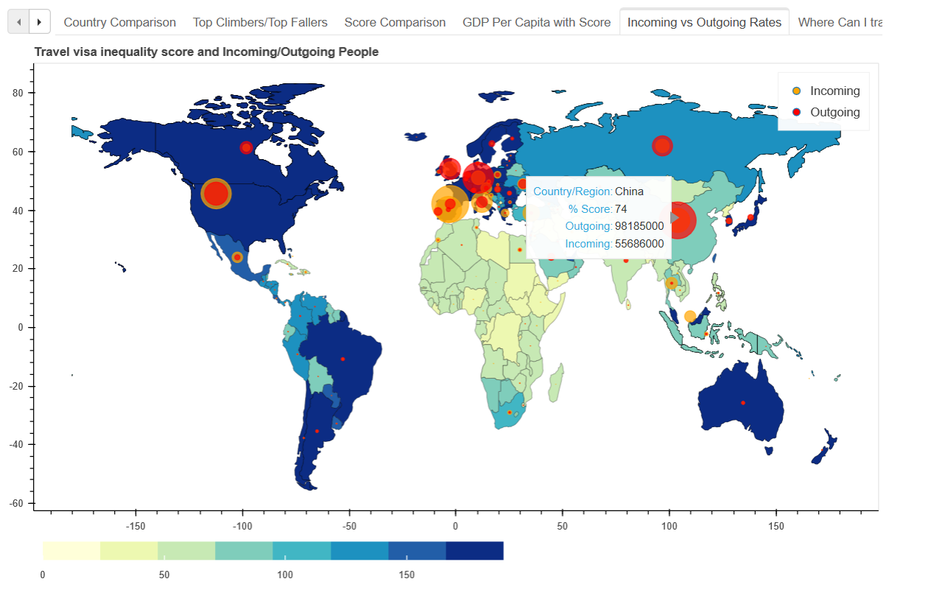
Score with Incoming vs. Outgoing

Slide 21
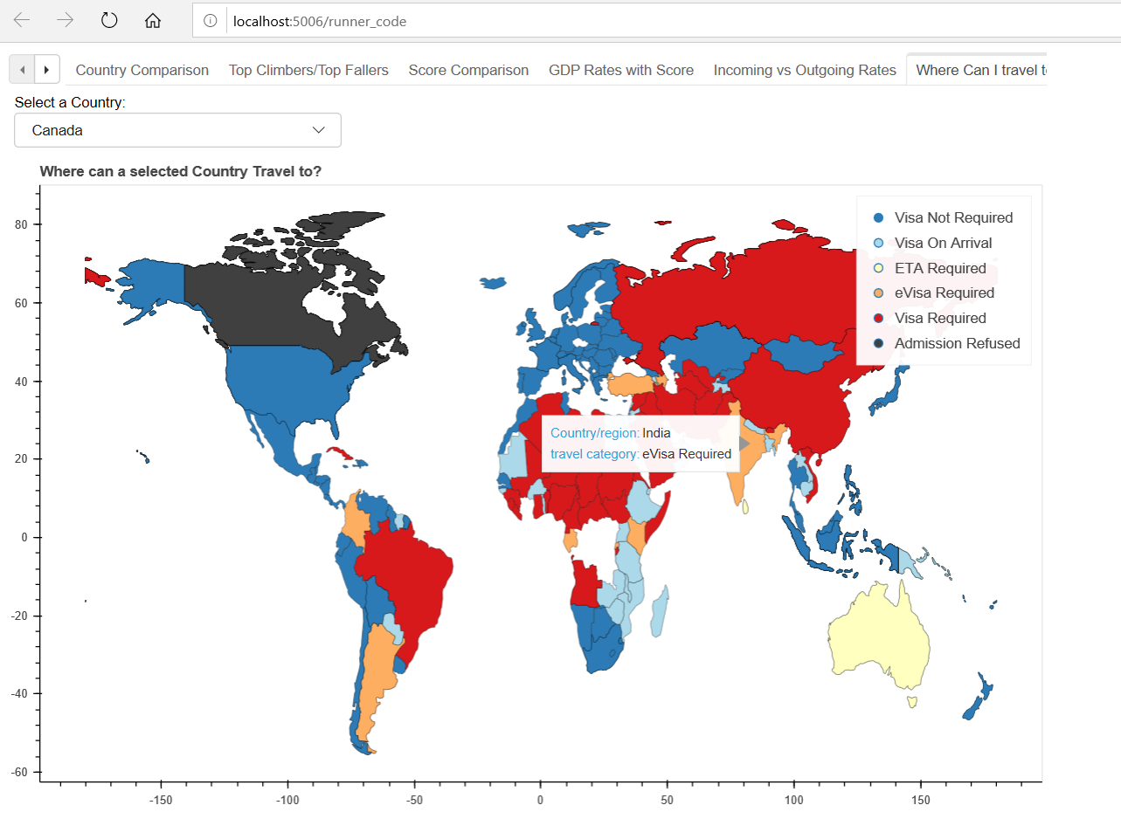
Where & How Can I travel?

Slide 22
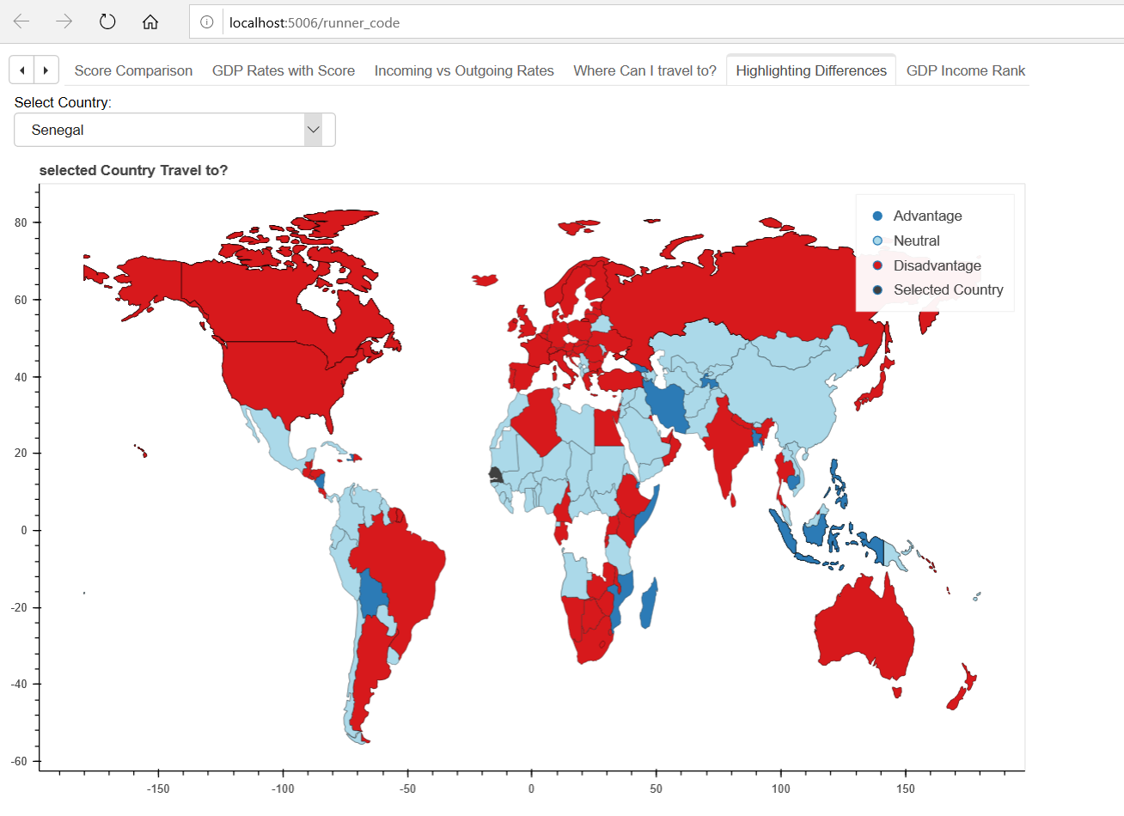
Highlighting Differences - Senegal

Slide 23
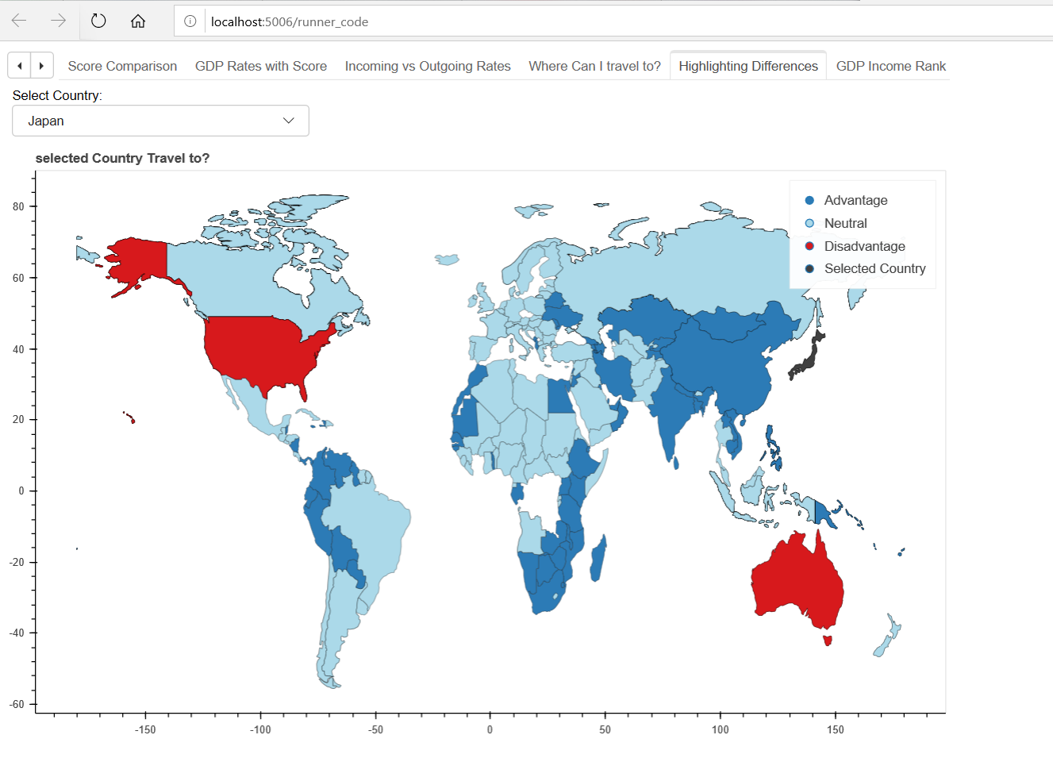
HighLighting Differences - Japan

Slide 24
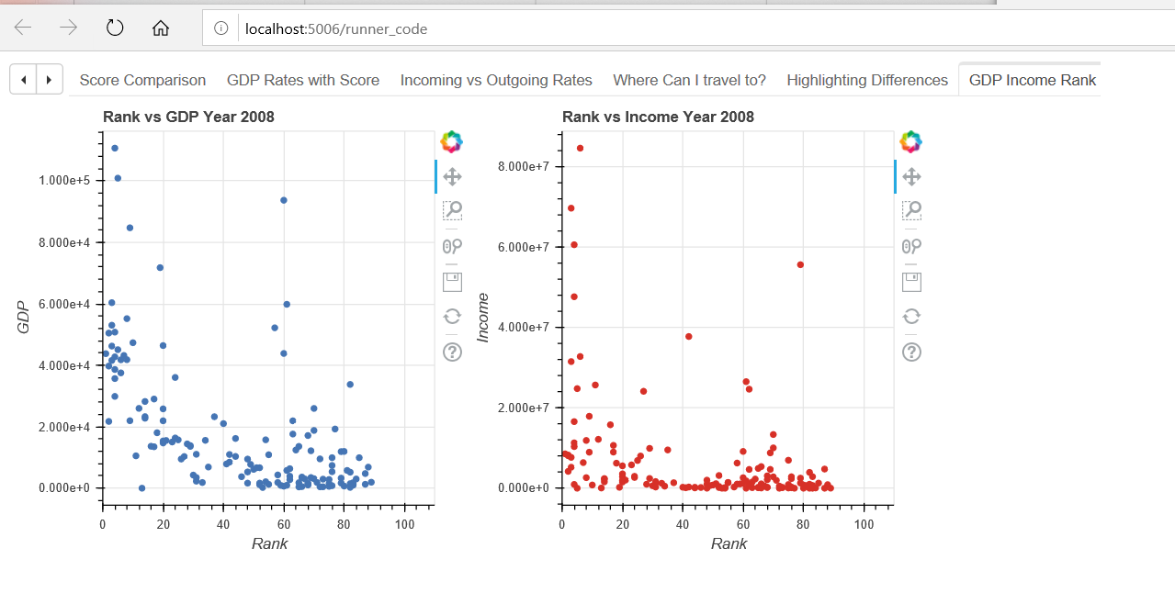
GDP & Income vs. Rank (Year 2006-2018)

Slide 25
Insights
Correlation between GDP per capita and Passport Rank
Correlation between Incoming and Passport Rank
Difference in Balanced / Welcoming / Restrictive
Evident from Visa Index Gradient Map that Asia(except Japan) and African Countries have poor visa index in comparison to other continent countries
Drastic difference between Senegal and Japan (Highlighting Differences)

Slide 26
Future Work
Include some more factors like education, technology, crime rates, healthcare to test the effect on visa mobility
Add more interactivity to the plots
Try to get more data for the factors above
Explore scraping for data about GDP, Incoming and Outgoing rates across all the years

